Slide 1


Tableau Visualization
By: Christopher Ashey

Slide 2
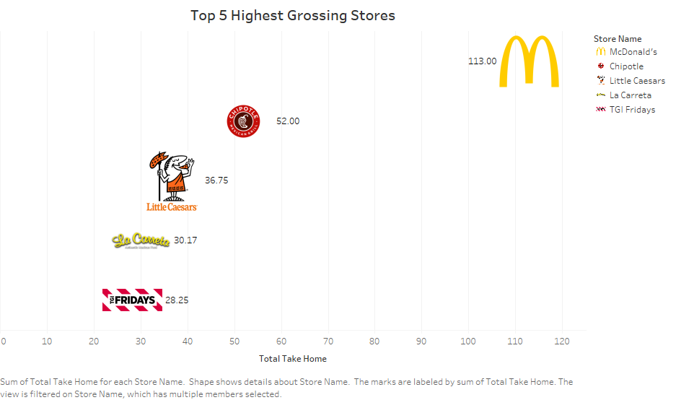

Slide 3
